Slide 1
Source of Recruitment.
The Visualization Patterns.

Slide 2
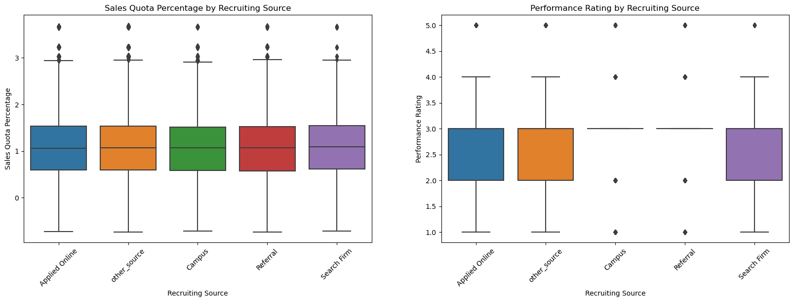
INSIGHTS WE GOT :
There too low values in campus and referral in recruiting source as by performance rating
And in sales quota is same in all the recruiting source.

Slide 3
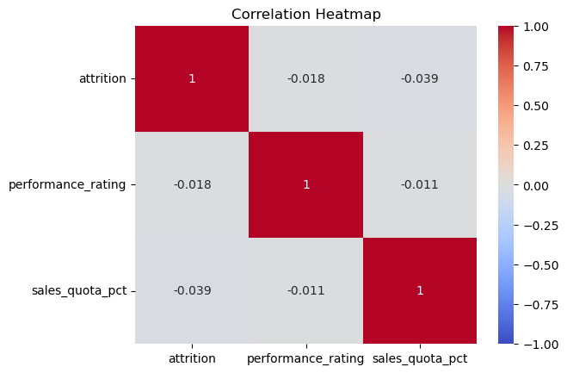
Insights We got here
There isn’t any relation between any feature with other feature so all features are independent from each other

Slide 4
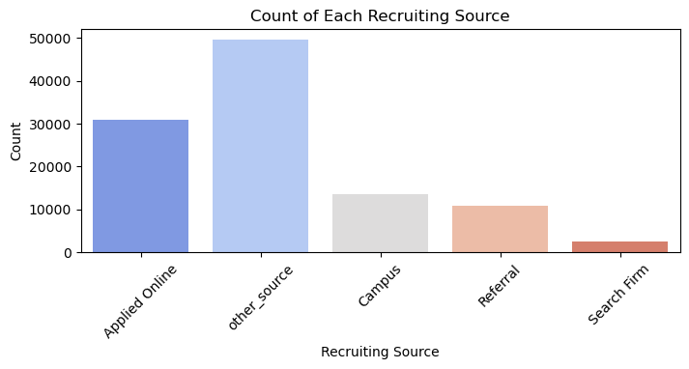
In Recruiting Source,
there are most employees enter through the help of other_source if we remove it the most of the recruitment is done by Online applied and least are done by Search Firm.

Slide 5
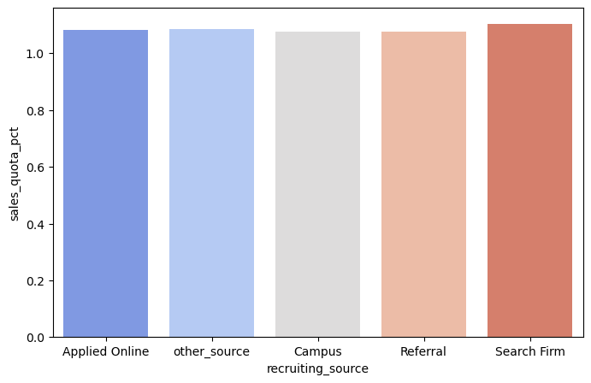
There are no such
visualizations

Slide 6
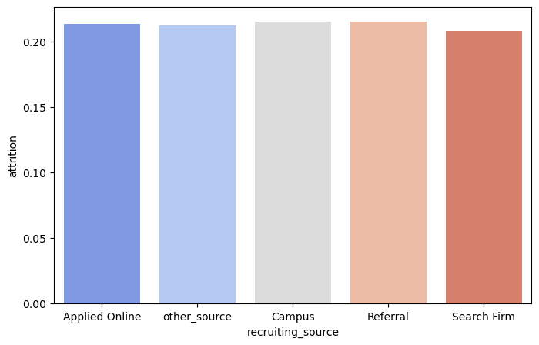
There are no such
visualizations

Slide 7
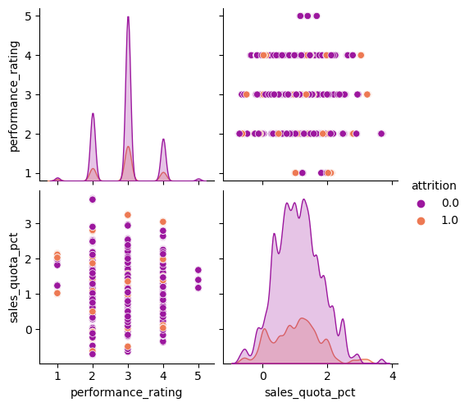

Slide 8
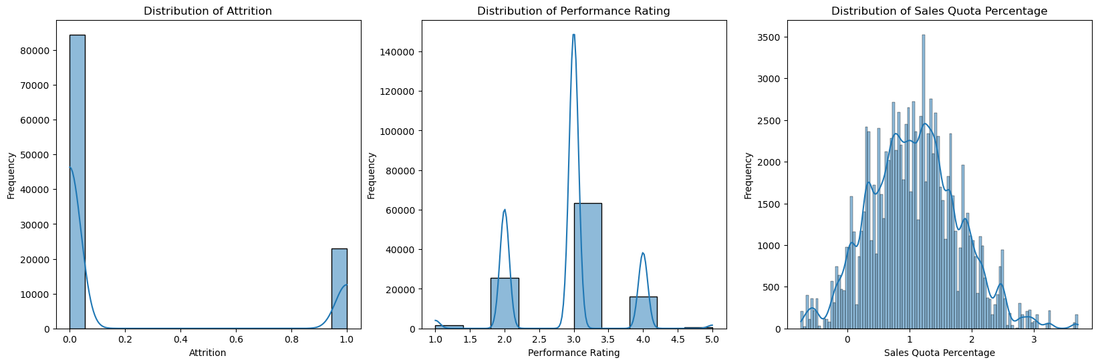
Insights :
There is distribution of attrition in 0 and 1 , other behalf mostly the employee gets 3 star performance rating more then 2 and 4 star and there is low performance for 5 performance rating. With there is a Normal distribution in Sales Quota Percentage.

